Slide 1
Impact of COVID-19 on ABC Company’s Parcel Delivery Business
Data-Driven Insights (2019–2020)
Presented by: Eneyi Simeni
Folarin Yusuf

Slide 2
Main Business Question
How did the COVID-19 pandemic impact ABC Company’s parcel business?
During the COVID-19 pandemic, ABC Company’s parcel delivery business in Canada experienced significant growth driven by the nationwide shift toward e-commerce, especially during lockdown periods. The pandemic acted as an accelerator for parcel volumes, with 2020 showing a substantial increase in shipment activity compared to the pre-pandemic year (2019).
Additional Business Questions
When were customer volumes first impacted?
What events triggered the shift?
What happened during peak season?
How were different customer groups affected?

Slide 3
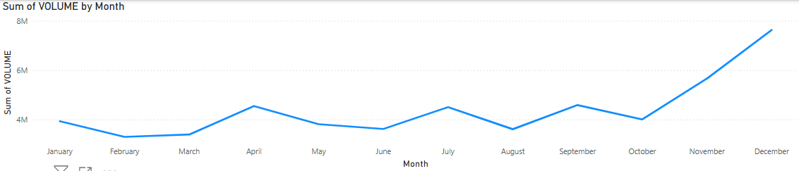
Main Business Questions cont’d
When were the customer first impacted; Mainly the second week in March 2019
What events triggered the shift: The lockdown emergency worldwide and fear of a major pandemic outbreak

Slide 4

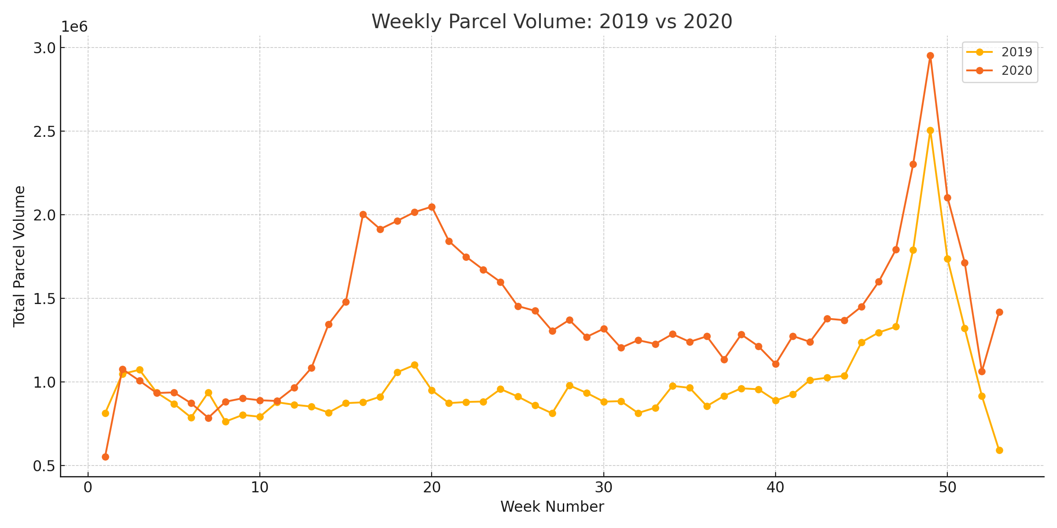

Weekly Parcel Volume Comparison
From our Python Code this Visualization was created, comparing both periods simultaneously.
Peak Periods was from week 42-50.

Slide 5

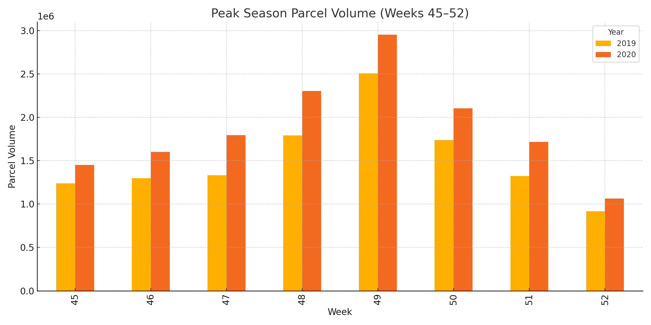
COVID Impact Timeline
Summary:
Compare Nov–Dec (Weeks 45–52) volumes
Holiday surge or decline in 2020

Slide 6
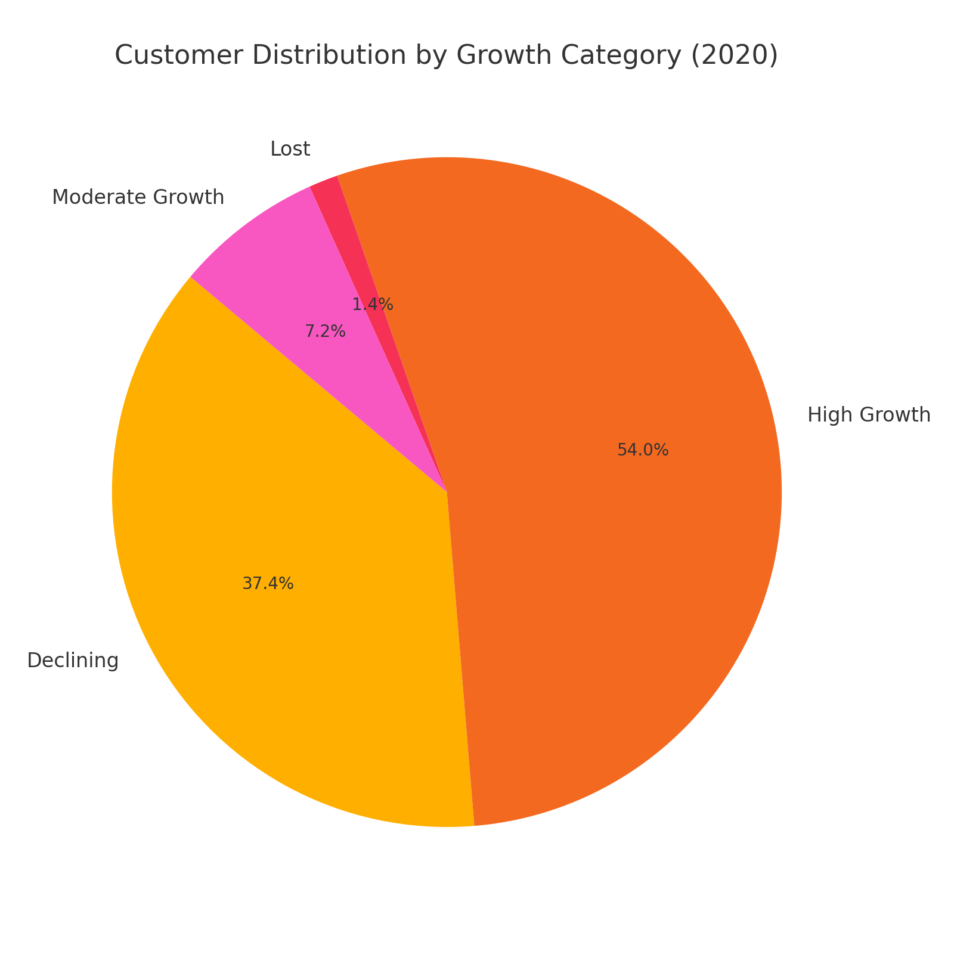
Customer Growth Classification
Insight: All customers who shipped in 2019 continued to ship in 2020. No new customers were acquired during the COVID period. This suggests ABC Company experienced strong customer retention with no churn and no onboarding of new clients.

Slide 7
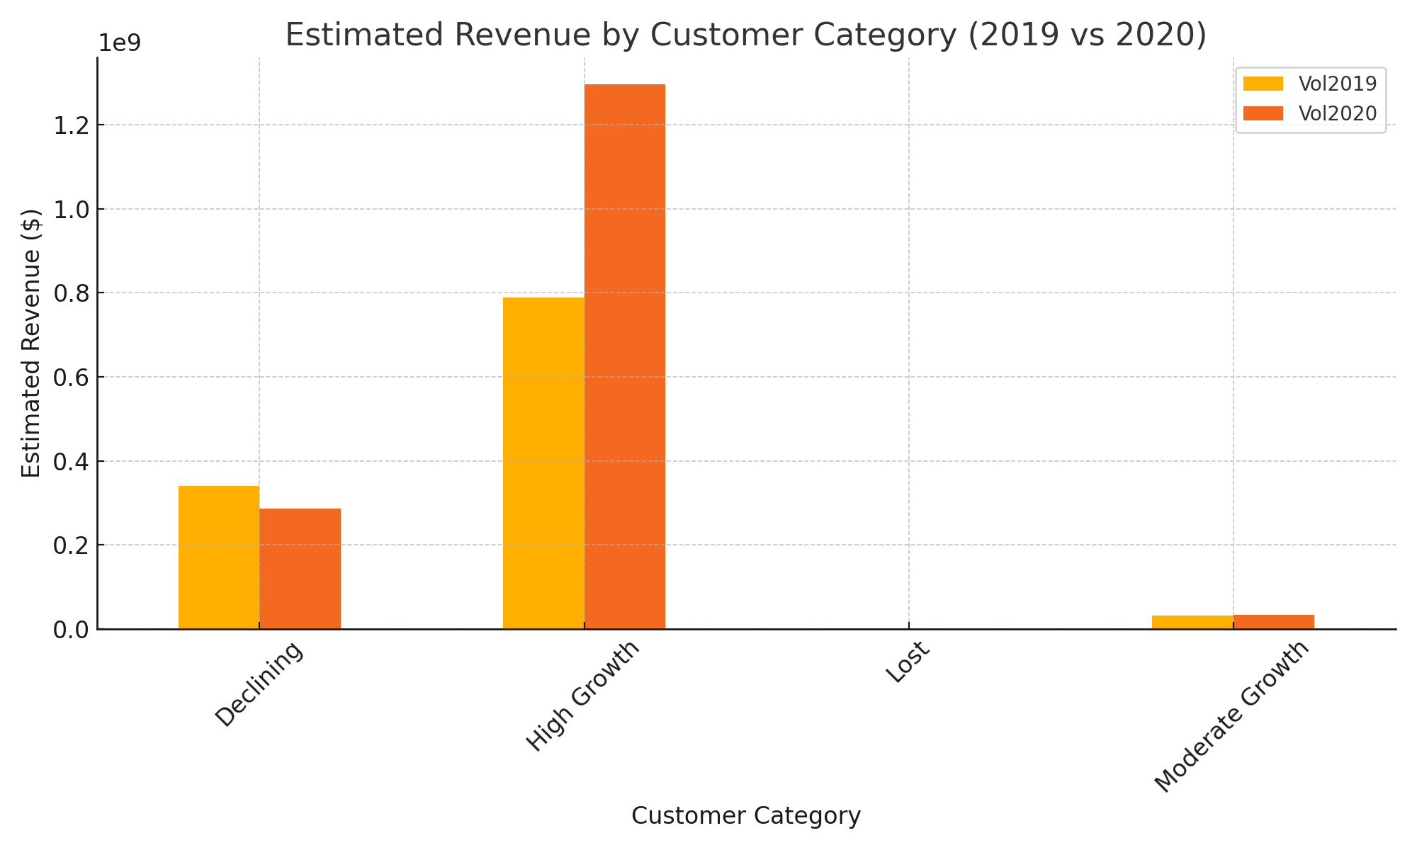
Revenue Contribution by Segment

Slide 8
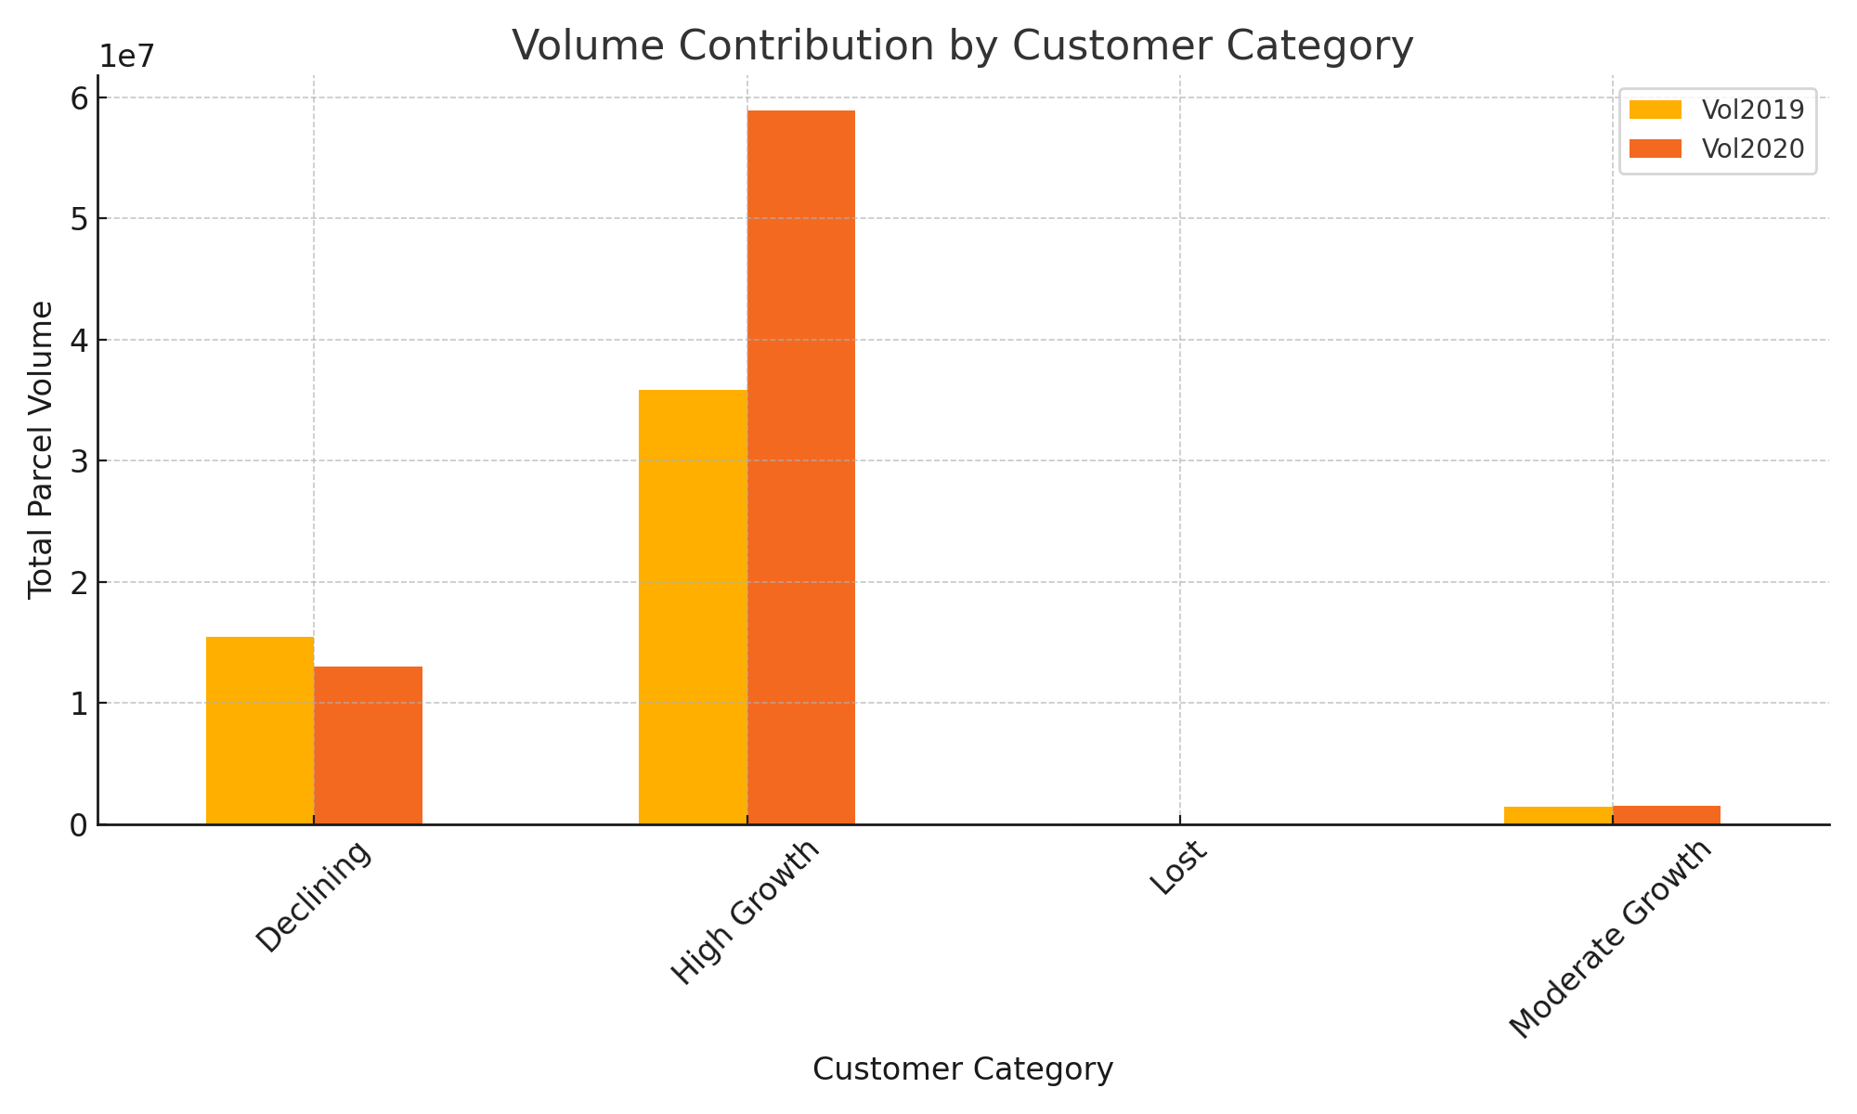
Key Recommendations

Slide 9
Conclusion
COVID accelerated parcel growth for ABC.
Focus: Retain core clients, support logistics surge, prep for future disruptions.
Thank you for your time

